Slide 1
CS2040S Tutorial 1
T33 Week 3
Please turn on your cameras, this is supposed to be a f2f class so it would be great if I can get to know your faces

Slide 2
Admin Matters

Slide 3
About me
Zhong Wei
Y2 Computer Science
Email: e0725590@u.nus.edu
Only if you can’t reach me via Telegram
Slower response time

Slide 4
Asking for help
Ask in the tutorial Telegram chat
Your tutorial mates will appreciate it :)
PM me on Telegram
For specific questions (e.g. your problem set submission)
Or just too shy for (1) – no one’s judging!
Coursemology comments
Same as (2) but slower

Slide 5
Some things
If I don’t reply on Telegram for >12 hours, message me again
Please don’t message me a few hours before your deadlines
Your deadlines are usually also my deadlines for other modules :)
My response times may be slower

Slide 6
Expectations for Tutorials
I will allow some time for latecomers. I will appreciate it if you can drop me a text if you are late/not coming so I know when to start
I intend to use slides (may change!), and I’ll send the slides to through the Telegram group once all tutorials are over
Discussion-based. I will experiment with some tutorial style but please feedback me whether it’s suitable
Your learning is important!!
Stop me if you are lost.

Slide 7
Structure of Tutorials
Go through the recent lecture topics in brief detail (~10 mins)
You guys take turns to answer tutorial questions + other random questions

Slide 8
Class participation
For each question I will do:
Before
10-20 seconds free-for-all (anyone can volunteer to answer)
If no one, I will call (in round-robin order)
During
Everyone is free to raise points about the question/answer to start a discussion
I will prompt if I think there is more to the question than we have discussed
After
If no one has anything to add for 10 seconds, we go next

Slide 9
Problem Sets
It is generally graded on time complexity + your ability to identify its run time + correctness.
If your algorithm hits the correct runtime bound and you pass all private test cases -> Full marks
Unsubmitting PS is not really allowed in CS2040S but I will allow it if you submitted it without completing the whole PS or I have not gotten a chance to look at your submission yet.

Slide 10
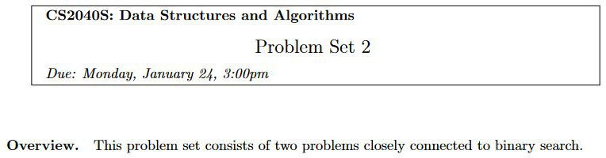
ps2 things
Read the question carefully!

Slide 11
ps2 things
Variable names:
Generally, we use camelCase instead of snake_case in Java.
For class names, we would use PascalCase .

Slide 12
ps2 things
Coding styles
Use names that reveal your intent
Good:
int[] register;
int currentLoad = 0;
Not so good:
int[] intArr;
int[] tells the reader it’s an int array, but what does it do?
int cl = 0;
I have to guess what cl stands for :(
Chances are, when you look at your code again 1 year later, you will too!

Slide 13
ps2 things
Guard Clauses instead of Nested Conditionals
if (x > 5) {
// do most of the work here
} else {
return 0;
}
Can be refactored to
if (x <= 5) {
return 0;
}
// do most of the work here

Slide 14
Tutorial Time

Slide 15
Brief Recap of lectures so far
Time complexity
Pre/Post-Conditions + Invariants
Binary Search/Peak Finding

Slide 16
Time complexity
Eg(T(n) = O/Ω/Θ(f(n))
Upper bound O
T(n) <= c * f(n) Lower bound Ω
T(n) >= c * f(n)
‘Tight’ bound Θ (doesn’t always exist)
T(n) = Θ(f(n)) iff T(n) = O(f(n)) && T(n) = Ω(f(n))

Slide 17
Time complexity
O(1) < O(logn) < O(n) < O(nlogn) < O(n²) < O(n³) < O(2^{n}) < O(n!)

Slide 18
Conditions and Invariants
Pre condition-> conditions that need to be met before your algo runs
Post condition -> basically the result of your algo
Invariants(IMPT) -> This is to prove the correctness of your algo

Slide 19
Peak Finding / Binary Search
Finding an element in O(logn) time given n elements if conditions are right
Divide and conquer
Checks the halfway mark, recurse left or right(based on condition) and repeat
Invariant(Why does it work) : Your answer will always be within the range of values you recurse on

Slide 20

Tutorial Qn 1 - Java Review

Slide 21
Tutorial Qn 1(a)
What is the difference between a class and an object? Illustrate with an example.

Slide 22
Tutorial Qn 1(a) Answer
A class can be seen as a `template', or a `blueprint', specifying what kind of
methods/operations should be supported and its behaviour.
An object is an instance of a class.

Slide 23
Tutorial Qn 1(b)
Why does the main method come with a static modifier?

Slide 24
Tutorial Qn 1(b) Answer
The static keyword is used to denote that the method belongs to the class (as a whole) rather than a particular instance
You can call a static member/method without even creating an instance of the class
Essentially, the main method being static allows it to be called without creating an instance of the object
You’ll learn more in CS2030S!

Slide 25
Tutorial Qn 1(c)
Give an example class (or classes) that uses the modifier private incorrectly (i.e., the program will not compile as it is, but would compile if private were changed to public).

Slide 26
Tutorial Qn 1(c) Answer
class SecretHolder {
private int secret;
class Test {
public static void main(String[] args){
SecretHolder holder = new SecretHolder(5);
public SecretHolder(int value){
this.secret = value;
}
holder.secret = 6; // Compile-time error!
}
}

Slide 27
Tutorial Qn 1(d)(i)
Why do we use interfaces?

Slide 28
Tutorial Qn 1(d)(i) Answer
An interface can be seen as a `contract' that is signed by a class whenever
it implements the interface. The reason for using interfaces is that whenever we see a class that implements that interface, we know for certain that it supports the operations specified by that interface.

Slide 29
Tutorial Qn 1(d)(ii)
Give an example of using an interface.

Slide 30
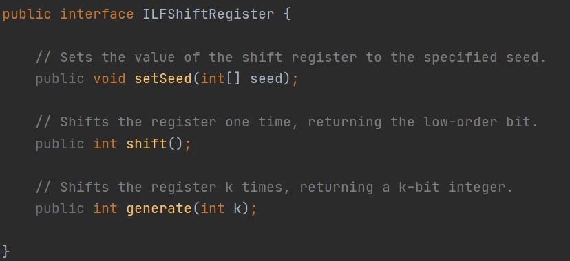
Tutorial Qn 1(d)(ii) Answer
Problem Set 1.

Slide 31
Tutorial Qn 1(d)(iii)
Can a method return an interface?

Slide 32
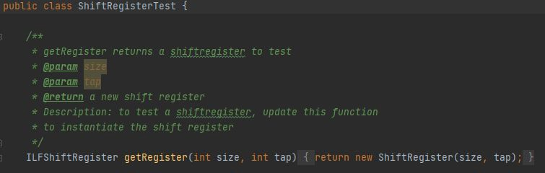
Tutorial Qn 1(d)(iii) Answer
Yes

Slide 33
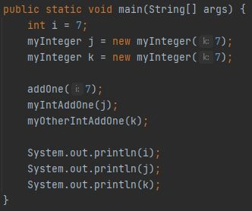
Tutorial Qn 1(e)
Refer to IntegerExamination.java.
Without running the code, predict the output of the main method.
Can you explain the outputs?

Slide 34
Tutorial Qn 1(e) Answer
I am in addOne. The value of i is 8
I am in myIntAddOne. The value of j is 8
I am in myOtherIntAddOne. The value of k is 8 The final value of i back in main is 7
The final value of j back in main is 8 The final value of k back in main is 7

Slide 35
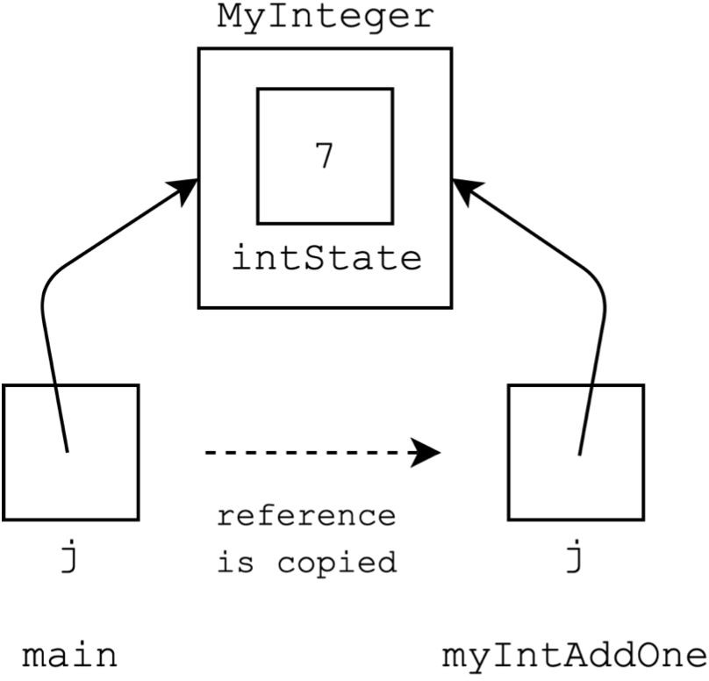
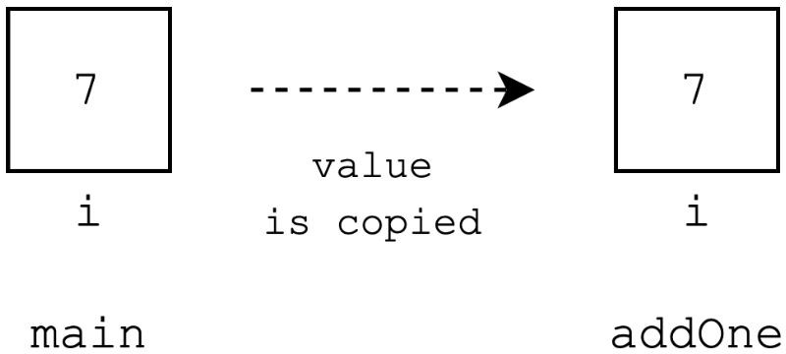
Pass by value

Slide 36
Tutorial Qn 1(f)
Can a variable in a parameter list for a method have the same name as a member (or static) variable in the class? If yes, how is the conflict of names resolved?

Slide 37
Tutorial Qn 1(f) Answer
class Example { int value = 5;
public void clash(int value) {
// Refers to the `value' argument. System.out.println(value);
// Refers to the `value' member in the class. System.out.println(this.value);
}
}

Slide 38

Tutorial Qn 2(a)

Slide 39

Tutorial Qn 2(a) Answer

Slide 40

Tutorial Qn 2(b)

Slide 41

Tutorial Qn 2(b) Answer

Slide 42

Tutorial Qn 2(c)

Slide 43
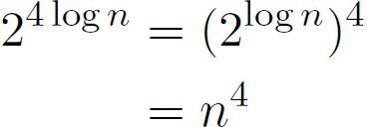

Tutorial Qn 2(c) Answer

Slide 44

Tutorial Qn 2(d)

Slide 45

Tutorial Qn 2(d) Answer

Slide 46
Break
Try these for fun:
I’ll go through them at the end if we have time

Slide 47


Tutorial Qn 3(a)

Slide 48

Tutorial Qn 3(a)

Slide 49
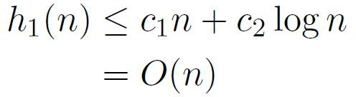
Tutorial Qn 3(a) Answer

Slide 50

Tutorial Qn 3(b)

Slide 51
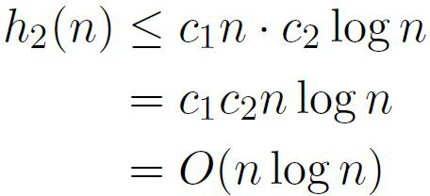
Tutorial Qn 3(b) Answer

Slide 52

Tutorial Qn 3(c)

Slide 53
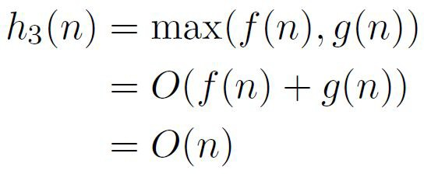
Tutorial Qn 3(c) Answer

Slide 54

Tutorial Qn 3(d)

Slide 55
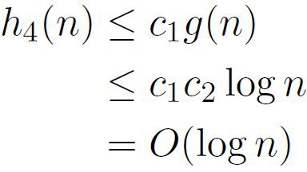
Tutorial Qn 3(d) Answer

Slide 56

Tutorial Qn 3(e)

Slide 57

Tutorial Qn 3(b) Answer
h(n) = O(
)

Slide 58
Tutorial Qn 4
Given a sorted array of n - 1 unique elements in the range [1, n], find the missing element?
Discuss possible naive solutions and possibly faster solutions.

Slide 59
Tutorial Qn 4 Answer
Naive: Go from 1- n, when the index does not match == missing element
Faster: Binary search -> check for ⌊ n/2 ⌋ if index matches the element, left side has no missing element

Slide 60
Tutorial Qn 5
Basically binary search again, but with a twist.
Not your usual if-else cases that you have learnt in the lecture.

Slide 61
Tutorial Qn 5 Answer
Things you know for sure:
Minimum k is 1, otherwise you will not do any pieces of homework at all
Maximum k is the max of all piles of homework. Any number greater will not make sense as this particular k already allow you to finish each pile in 1 hour.

Slide 62
Tutorial Qn 5 Answer
Naïve solution: Linear search 1 -> n
Faster: binary search: Find middle value ⌊ (1 + n)/2 ⌋ of k, check if value is valid(finish within h hours. If valid, recurse on left half, to find smaller k If not valid, recurse on right half to find larger k

Slide 63
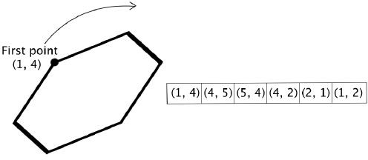
Tutorial Qn 5 Qn
Find bounding box

Slide 64
Tutorial Qn 5 Answer
Find bounding box -> min, max x and y values.
Look for the pattern in the pairs. (aka property of the polygon)
X coords and Y coords can only have 4 graph shapes

Slide 65
Tutorial Qn 5 Answer
Peak ﬁnd/binary search on the graph. (ps2)
For the zigzag graph, note that since it is a closed polygon, the start point will not cross once more with the end point.
Therefore, by doing bin search, u can guarantee that the local
maximum/minimum -> global maximum/minimum

Slide 66
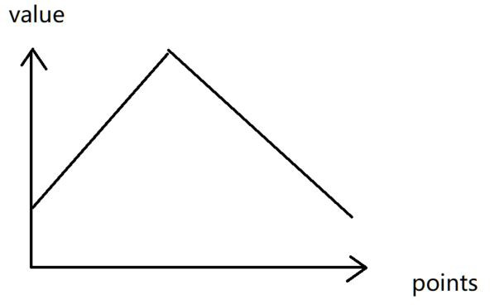
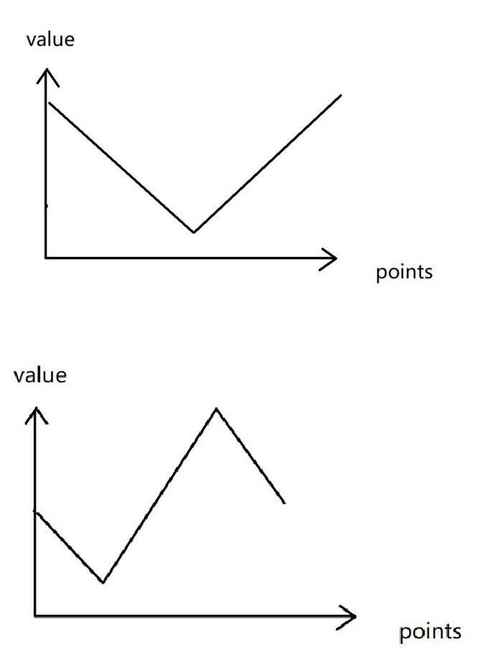
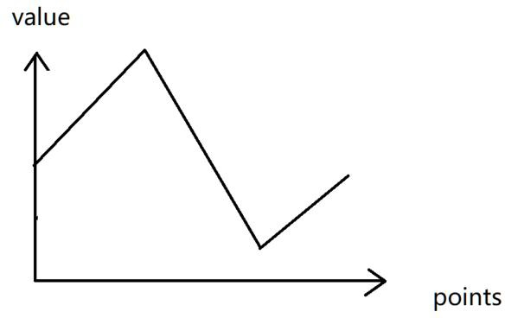
Tutorial Qn 5 Answer

Slide 67
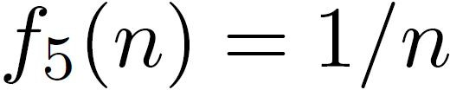
More Bonus stuff

Slide 68

More Bonus stuff answer

Slide 69
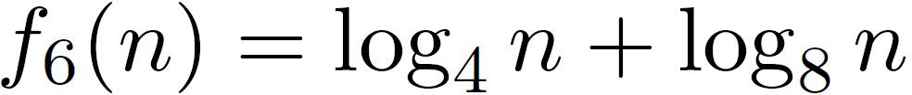
More Bonus stuff

Slide 70

More Bonus stuff answer

Slide 71
More Bonus stuff

Slide 72

More Bonus stuff answer

Slide 73

More Bonus stuff

Slide 74

More Bonus stuff answer

Slide 75

More Bonus stuff

Slide 76

More Bonus stuff answer

Slide 77

More Bonus stuff

Slide 78



More Bonus stuff answer
W.R.T to n
W.R.T to m
W.R.T to n and m

Slide 79
Appendix: Complexities
Credits to Hanming for the subsequent slides

Slide 80
Complexities
COMMON MISCONCEPTION
Big-O = Worst Case
Big-Omega = Best Case Big-Theta = Average Case
Not correct!!

Slide 81
Complexities
Correct Interpretation
Big-O = Asymptotic upper bound for some specific case
Big-Omega = Asymptotic lower bound for some specific case Big-Theta = Asymptotic tight bound for some specific case

Slide 82
Complexities
Correct Interpretation
Big-O = Asymptotic upper bound for some specific case
Big-Omega = Asymptotic lower bound for some specific case Big-Theta = Asymptotic tight bound for some specific case
This means we can calculate the Big-O, Big-Omega and Big-Theta (if it exists) for any case, e.g. worst case, best case and average case!

Slide 83
Complexities
Correct Interpretation
Big-O = Asymptotic upper bound for some specific case
Big-Omega = Asymptotic lower bound for some specific case Big-Theta = Asymptotic tight bound for some specific case
This means we can calculate the Big-O, Big-Omega and Big-Theta (if it exists) for any case, e.g. worst case, best case and average case!
i.e. the bounds are independent of the type of case

Slide 84
Best case, Worst case, Average case?
For a given input of size n, complexity also depends on the exact data

Slide 85
Best case, Worst case, Average case?
For a given input of size n, complexity also depends on the exact data
Best case: Minimum time/space needed among all possible inputs of size n

Slide 86
Best case, Worst case, Average case?
For a given input of size n, complexity also depends on the exact data
Best case: Minimum time/space needed among all possible inputs of size n
Worst case: Maximum time/space needed among all possible inputs of size n

Slide 87
Best case, Worst case, Average case?
For a given input of size n, complexity also depends on the exact data
Best case: Minimum time/space needed among all possible inputs of size n
Worst case: Maximum time/space needed among all possible inputs of size n
Average case: Average time/space needed over some finite set of inputs, where each input is of size n. The “finite set” may or may not be the set of all inputs of size n.

Slide 88
Best case, Worst case, Average case?
For a given input of size n, complexity also depends on the exact data
Best case: Minimum time/space needed among all possible inputs of size n
Worst case: Maximum time/space needed among all possible inputs of size n
Average case: Average time/space needed over some finite set of inputs, where each input is of size n. The “finite set” may or may not be the set of all inputs of size n.
Generally, we are most interested in worst-case complexity.

Slide 89
Representing complexity
Generally, we represent complexity as a function of the input size n
e.g. f(n) = 45n² + 23n + 5

Slide 90
Representing complexity
Generally, we represent complexity as a function of the input size n
e.g. f(n) = 45n² + 23n + 5
We would then simplify such functions using asymptotic notations:
f(n) = Θ(n²)

Slide 91
Representing complexity
Generally, we represent complexity as a function of the input size n
e.g. f(n) = 45n² + 23n + 5
We would then simplify such functions using asymptotic notations:
f(n) = Θ(n²)
Why is this okay?

Slide 92
Representing complexity
Generally, we represent complexity as a function of the input size n
e.g. f(n) = 45n² + 23n + 5
We would then simplify such functions using asymptotic notations:
f(n) = Θ(n²)
The time complexity can be viewed as the number of machine-level instructions (rather than for example, seconds) and that the precise number of instructions for a given algorithm actually depends on the compiler, CPU architecture, and so on. So f(n) can never be exact.

Slide 93
Representing complexity
Generally, we represent complexity as a function of the input size n
e.g. f(n) = 45n² + 23n + 5
We would then simplify such functions using asymptotic notations:
f(n) = Θ(n²)
The time complexity can be viewed as the number of machine-level instructions (rather than for example, seconds) and that the precise number of instructions for a given algorithm actually depends on the compiler, CPU architecture, and so on. So f(n) can never be exact.
Similarly, the space complexity depends on the compiler, CPU architecture, and so on.

Slide 94
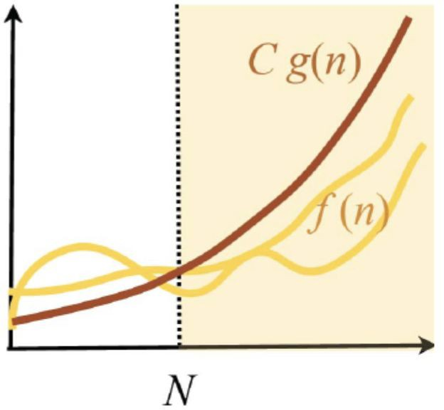
Understanding Big-O - Asymptotic Upper Bounds
Let f(n) and g(n) be positive valued functions. We say
f(n) ∈ O(g(n))
if there exists constants N > 0 and C > 0 such that for all n > N,
f(n) ≤ Cg(n)

Slide 95
Understanding Big-O - Asymptotic Upper Bounds
Let f(n) and g(n) be positive valued functions. We say
f(n) ∈ O(g(n))
if there exists constants N > 0 and C > 0 such that for all n > N,
f(n) ≤ Cg(n)
Formally, O(g(n)) is a set of functions that contains all functions f(n) satisfying the above conditions. We often abuse notation and say
f(n) = O(g(n))

Slide 96
Understanding Big-O - Asymptotic Upper Bounds
Quick test: If f(n) = O(n²), then is f(n) = O(n³)?

Slide 97
Understanding Big-O - Asymptotic Upper Bounds
Quick test: If f(n) = O(n²), then is f(n) = O(n³)?
Yes, because if we look at O(n²) and O(n³) as sets of functions, then we can clearly see that
O(n²) ⊆ O(n³)
Since f(n) ∈ O(n²), then f(n) ∈ O(n³).

Slide 98
Understanding Big-O - Asymptotic Upper Bounds
Quick test: If f(n) = O(n²), then is f(n) = O(n³)?
Yes, because if we look at O(n²) and O(n³) as sets of functions, then we can clearly see that
O(n²) ⊆ O(n³)
Since f(n) ∈ O(n²), then f(n) ∈ O(n³).
So this upper bound may not be the tightest upper bound!

Slide 99
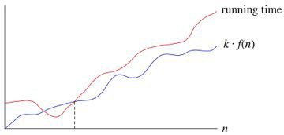
Understanding Big-Ω - Asymptotic Lower Bounds
Let f(n) and g(n) be positive valued functions. We say
f(n)
Cg(n)
f(n) ∈ Ω(g(n))
if there exists constants N > 0 and C > 0 such that for
all n > N,
N
f(n) ≥ Cg(n)

Slide 100
Understanding Big-Ω - Asymptotic Lower Bounds
Let f(n) and g(n) be positive valued functions. We say
f(n)
Cg(n)
f(n) ∈ Ω(g(n))
if there exists constants N > 0 and C > 0 such that for
all n > N,
N
f(n) ≥ Cg(n)
Formally, Ω(g(n)) is a set of functions that contains all functions f(n) satisfying the above conditions. We often abuse notation and say
f(n) = Ω(g(n))

Slide 101
Understanding Big-Ω - Asymptotic Lower Bounds
Quick test: If f(n) = Ω(n²), then is f(n) = Ω(n)?

Slide 102
Understanding Big-Ω - Asymptotic Lower Bounds
Quick test: If f(n) = Ω(n²), then is f(n) = Ω(n)?
Yes, because if we look at Ω(n²) and Ω(n) as sets of functions, then we can clearly see that
Ω(n²) ⊆ Ω(n) Since f(n) ∈ Ω(n²), then f(n) ∈ Ω(n).

Slide 103
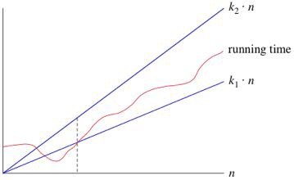
Understanding Big-Θ - Asymptotic Tight Bounds
C₁g(n)
Let f(n) and g(n) be positive valued functions. We say
f(n)
f(n) ∈ Θ(g(n))
C₂g(n)
if
f(n) ∈ Ω(g(n)) and f(n) ∈ O(g(n))
N₁ N₂

Slide 104
Understanding Big-Θ - Asymptotic Tight Bounds
C₁g(n)
Let f(n) and g(n) be positive valued functions. We say
f(n)
f(n) ∈ Θ(g(n))
C₂g(n)
if
f(n) ∈ Ω(g(n)) and f(n) ∈ O(g(n))
N₁ N₂
Note that in the graph above, N₁ does not need to be the same as N₂, and C₁ does not need to be the same as C₂!
We are just looking at the intersection between the two sets, Ω(g(n)) and O(g(n)).

Slide 105
Appendix: Recursion Trees

Slide 106
Recursion Tree Drawing Technique
What happens during exams when you simply cannot figure out the complexity?
This is especially for questions involving recursion!

Slide 107
Recursion Tree Drawing Technique
What happens during exams when you simply cannot figure out the complexity?
This is especially for questions involving recursion!
Common question:
- How can I calculate the complexity of function g if g calls itself?
I need the complexity of g to calculate the complexity of g!

Slide 108
Recursion Tree Drawing Technique
We can draw the recursion tree! (Note: this is not exactly taught in CS2040S, but it may make things a lot easier to see.)
4-step process:
Draw the recursion tree
Find the height of the recursion tree
Find the work done at every node in the tree
Find the work done at every level of the tree
This is just the sum of work done by each node in each level
See if you can spot some kind of pattern

Slide 109
Demo of the Technique
Let’s say we have the function below:
Foo(n):
if n <= 1 then return
else
DoThetaOne(); // runs in Θ(1) time Foo(n/2);
Foo(n/2);
end
end
What’s the time complexity of this function?

Slide 110
Demo of the Technique
Step 1: Draw the recursion tree
n
n / 2
n / 2
n / 4
n / 4
n / 4
n / 4

Slide 111
Demo of the Technique
Step 2: Find the height of tree
n
n / 2
n / 2
log n
n / 4
n / 4
n / 4
n / 4

Slide 112
Demo of the Technique
Step 3: Find work done at each node
1
n
1
1
n / 2
n / 2
log n
1
1
1
1
n / 4
n / 4
n / 4
n / 4

Slide 113
Demo of the Technique
Step 4a: Find work done
at every level
1
n
1
1
1
n / 2
n / 2
2
log n
1
1
1
1
n / 4
n / 4
n / 4
n / 4
4

Slide 114
Demo of the Technique
Step 4b: Finding a pattern
At 1st layer of recursion, 1 operation is performed.
At 2nd layer of recursion, 2 operations are performed. At 3rd layer of recursion, 4 operations are performed.
…
At the kth layer of recursion, 2^{k - 1} operations are performed.

Slide 115
Demo of the Technique
Step 4b: Finding a pattern
At 1st level of recursion, 1 operation is performed.
At 2nd level of recursion, 2 operations are performed. At 3rd level of recursion, 4 operations are performed.
…
At the
log n
th level of recursion,
₂log n - 1
operations are performed.
We have
log n
levels of recursion.

Slide 116
Demo of the Technique
Step 4c: Summing Everything Up
1 + 2 + 4 + … + 2^{log n - 1}
≤ 2n (geometric series)
= Θ(n)
More precisely, we can see that 1 + 2 + … + 2^{k} = 2^{k + 1} - 1
Example: 1 + 2 + 4 + 8 = 2⁰ + 2¹ + 2² + 2³ = 15 = 16 - 1 = 2⁴ - 1
₌ ₂log n ₋ ₁
= n - 1
= Θ(n)
Thus, we have 1 + 2 + 4 + … + 2^{log n - 1}

Slide 117
Using Recursion Tree for Merge Sort
Step 1: Draw the recursion tree
n
n / 2
n / 2
n / 4
n / 4
n / 4
n / 4

Slide 118
Using Recursion Tree for Merge Sort
Step 2: Find the height of tree
n
n / 2
n / 2
log n
n / 4
n / 4
n / 4
n / 4

Slide 119
Using Recursion Tree for Merge Sort
Step 3: Find work done at each node
n
n
n / 2
n / 2
n / 2
n / 2
log n
n / 4
n / 4
n / 4
n / 4
n / 4
n / 4
n / 4
n / 4

Slide 120
Using Recursion Tree for Merge Sort
Step 4a: Find work done
at every level
n
n
n
n / 2
n / 2
n / 2
n / 2
n
log n
n / 4
n / 4
n / 4
n / 4
n / 4
n / 4
n / 4
n / 4
n

Slide 121
Using Recursion Tree for Merge Sort
Step 4b: Finding a pattern
At 1st layer of recursion, n operations is performed. At 2nd layer of recursion, n operations are performed. At 3rd layer of recursion, n operations are performed.
…
At the log n th layer of recursion, n operations are performed.

Slide 122
Using Recursion Tree for Merge Sort
Step 4c: Summing Everything Up
n + n + n + … + n = n log n
log n copies
= Θ(n log n)

